Slide 1
Welcome Chapter Members!
Time | Activity | Presenter
5:30 - 6:00 | Registration & Networking
6:00 - 6:30 | Dinner
6:30 – 6:45 | Chapter Bylaw Updates / Approval | Cheri Schettl
6:45 – 7:00 | Candidate Information / Elections | Fran Davis-Rentmeester
7:00 – 7:15 | State of the Chapter | Angie Buchholz
7:15 - 7:45 | Mind over Matter – Fabulous Prizes | Angie Buchholz
7:45 – 8:00 | Closing Remarks | Angie Buchholz

Slide 2
Board Benefits
Board positions have full voting rights, an anticipated commitment of about 8-12 hours per month, and the following benefits:
All chapter membership and meeting fees waived
Exposure to leaders in the business analysis profession as well as in the local community
Ability to provide direct input in development and governance of the Chapter
Opportunity to build solid leadership skills
Time counted toward volunteer hours for CBAP® Recertification

Slide 3
Board Elections
Per Chapter Bylaws, board member elections are to be held each year at our Annual General Meeting. Board member terms are staggered so only some of the board members are elected each year.
This year’s board member elections include:
VP of Administration
VP of Education & Certification
VP of Membership & Sponsorship
VP of Strategy
Director of Accounting
Director of Technology
President-Elect

Slide 4
Chapter Bylaws – Updates and Approval
Discuss Changes
Removed redundancies
Remove past president role
Extend Presidency
Approval and Sign

Slide 5
Board Candidates
VP of Administration- Bryan Moran
VP of Education & Certification – Dmitri Martin
VP of Membership & Sponsorship – Shelby Hujet
VP of Strategy
Director of Accounting
Director of Technology – Shawn Diamond
President-Elect – Chris Petersen

Slide 6
Financial Highlights
Financial Highlights
Total Assets as of 12/31/16 - $7,285
Total Revenue for the Twelve Months Ended 12/31/16 - $9,643; sponsorships (47%), meeting fees (26%), memberships (19%)
Total Expenses for the Twelve Months Ended 12/31/16 - $8,293; majority of expenses are for meetings and credit card processing
Profit - $1,350; a significant increase over prior year

Slide 7
2016 Objectives and Results
2014 Objectives and Results
Increase Visibility
Increase registration 16% ☺
2013-2014: 19 to 23, 20% increase
2014-2015: 23 to 37, 60% increase
2015-2016: 37 to 44, 16% increase
Increase membership 10% ☺
2014 members: 74, 10% increase
2015 members: 83, 10% increase
2016 members: 93, 10% increase
Increase Sponsorship 15% ☺
2014 - 1 Platinum, 3 Gold, and 1 Silver, 25% increase
2015 – 2 Platinum, 3 Gold, and 1 Silver, 20% increase
2016 - 2 Platinum, 3 Gold, and 2 Silver, 15% increase

Slide 8
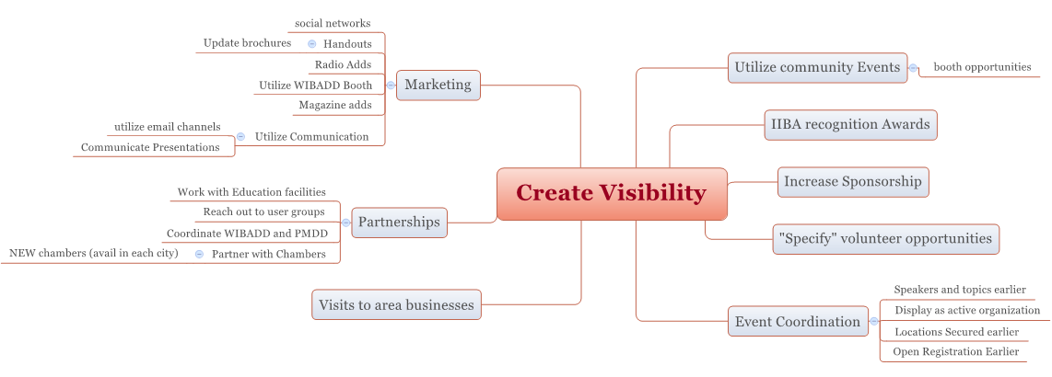
2017 Strategy
2015 Goals and Objectives

Slide 9
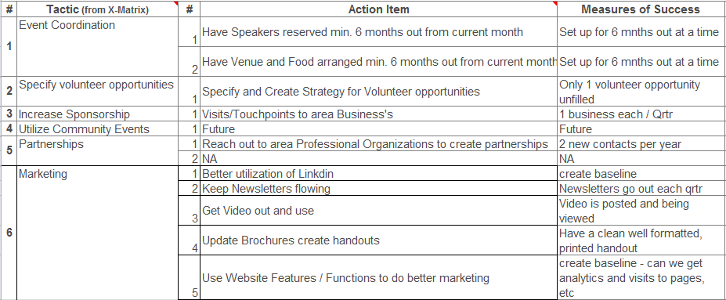
2017 Strategy
2015 Goals and Objectives

Slide 10
Current Sponsors
Platinum
Gold
Silver
Bronze
Multiple event venue and hospitality providers.

Slide 11
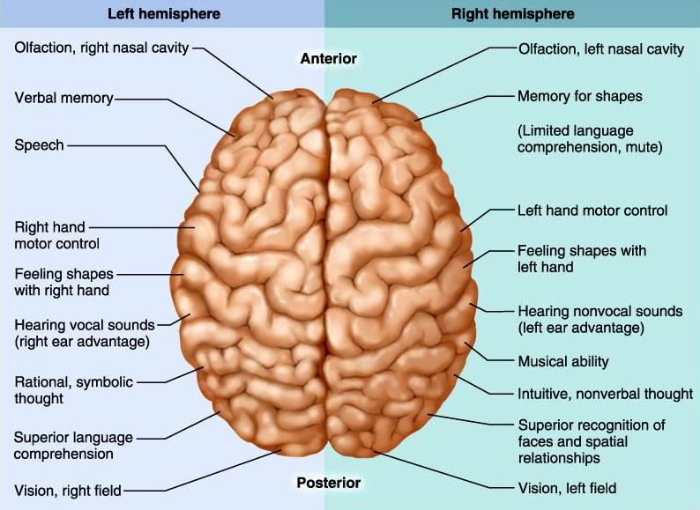
Mind Over Matter – Left vs Right

Slide 12
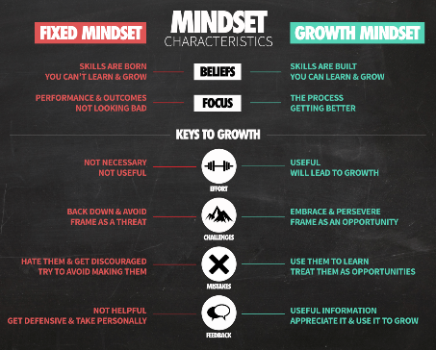
Mind Over Matter – Mindsets

Slide 13
Mind Over Matter – Game

Slide 14
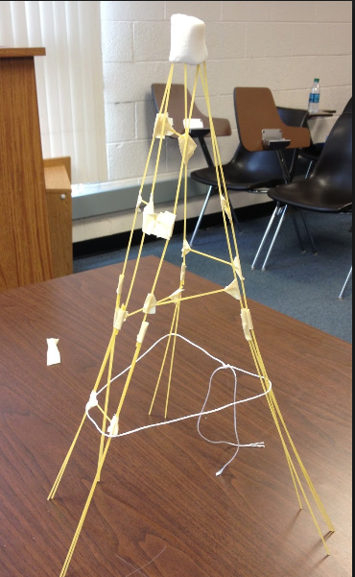
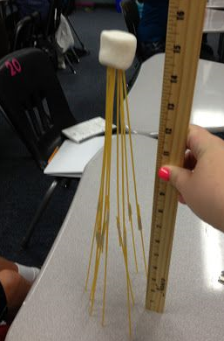
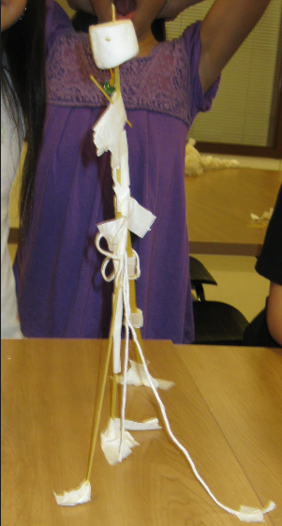
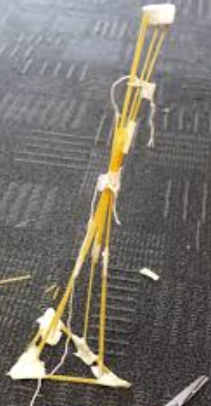
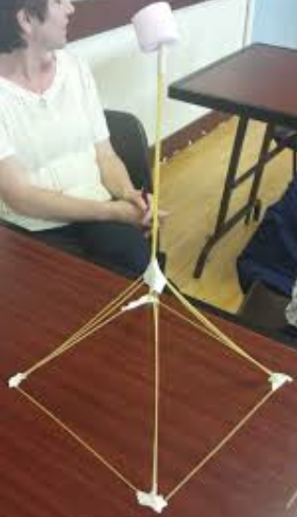
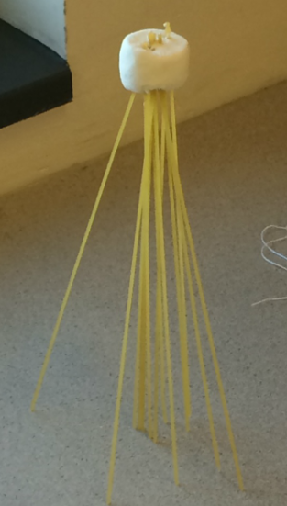
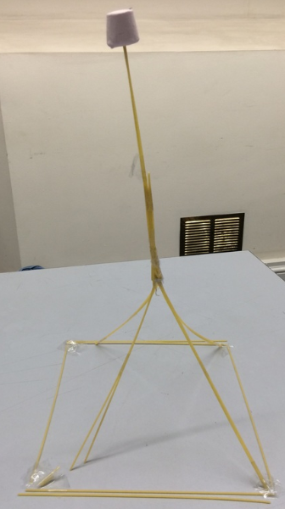
Mind Over Matter – Game

Slide 15
WI BADD™ 2017
2017 Wisconsin Business Analyst Development Day (WI BADD™)
WHEN: Tuesday, May 9th, 2017
WHERE: Alliant Energy Center, Madison, Wisconsin
WHO: Business Analysts, Systems Analysts, QA Analysts, Managers,
Project Managers
WHAT: Development Tracks
Earn continuing development units (CDU)
Networking!!!
Food, Fun and Awesome DOOR PRIZES!!
More information at http://wibadd.org/

Slide 16
Closing Remarks
March Meeting
Open Positions
Drawing for large prize
Thank you

